Slide 1
Welcome!
Please, have a seat.
CWRU Quants
quants@case.edu
Notes:
Sources: https://github.com/CppCon/CppCon2017/blob/master/Presentations/When%20a%20Microsecond%20Is%20an%20Eternity/When%20a%20Microsecond%20Is%20an%20Eternity%20-%20Carl%20Cook%20-%20CppCon%202017.pdf https://blog.cloudflare.com/branch-predictor/

Slide 2
Agenda
Food!
Exec Updates and Next Years Club Structure
Final Report Out
Notes:
Christo

Slide 3



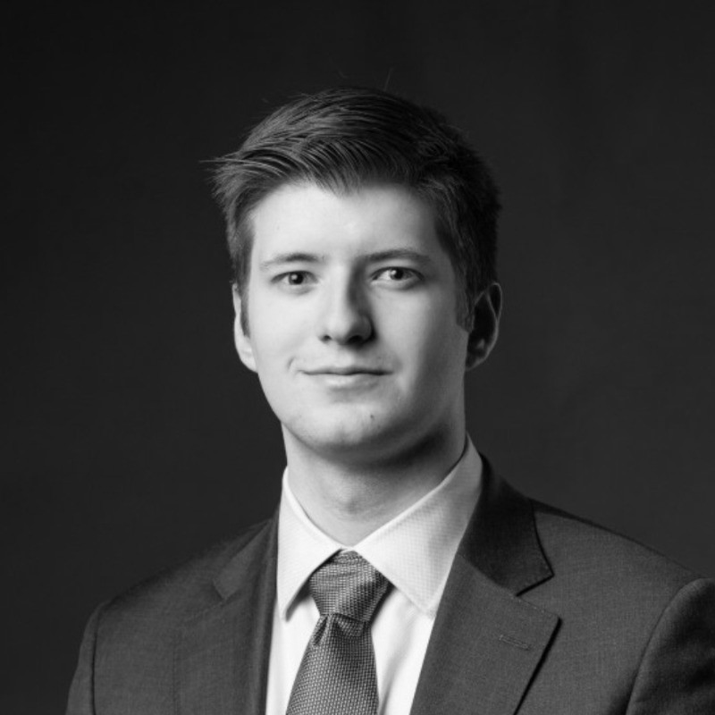
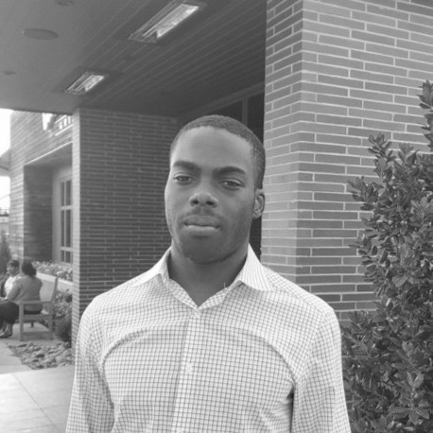
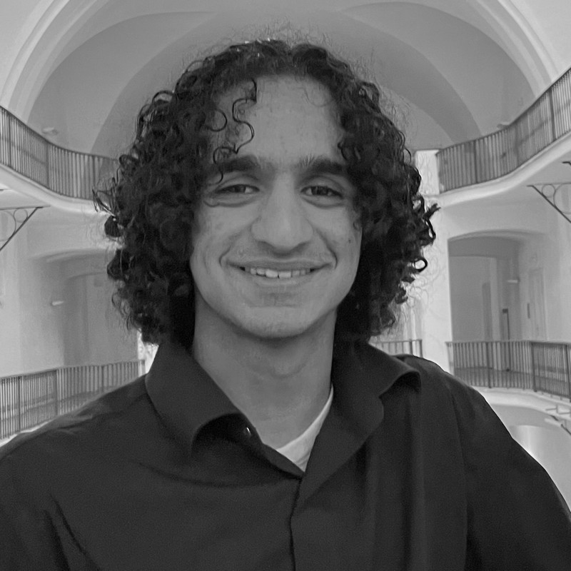
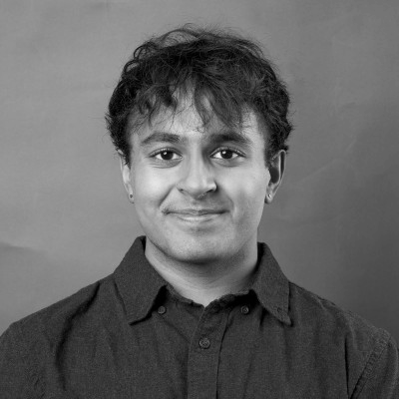
2025-2026 Executive Team
Ethan Fang
President
Computer Science Rising Senior
Incoming Quant @ Keybank
ML Research
Karel Stryczek
Vice President
Applied Math and Statistics Rising Junior
August Matkov
Treasurer
CS/Finance Rising Senior
Ray Ikome
Head
CS and Math Sophomore
SWE @ Microsoft
SWE @ Google
SWE @ Weatherhead
Sidharth Jindal
Head
Math BS/MS + Econ Sophomore
ML Theory Research @ CWRU Math Department
TA @ Weatherhead
Monish Sinha
Head
Rising Data Science Junior
Notes:
Christo

Slide 4
Trading Team
“Trading is a game of probabilities. You don’t have to be right every time. You just have to follow your rules.”
—source?
Notes:
Transition

Slide 5
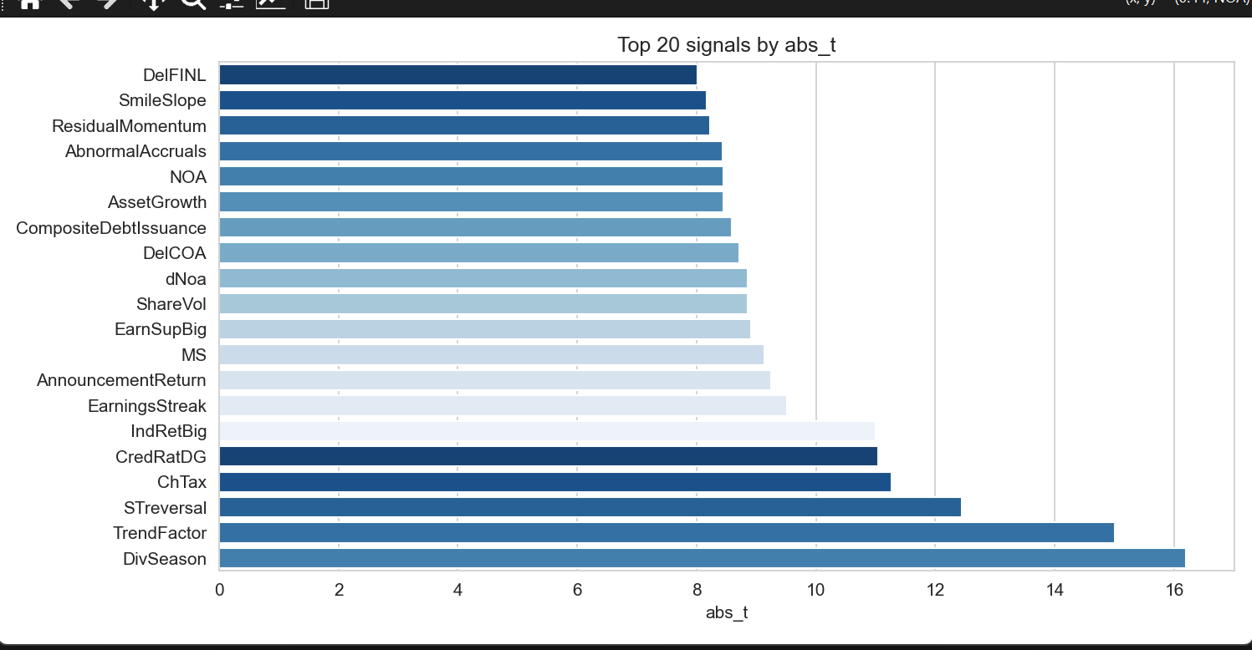
Signal Selection and Processing for Trading
Goal was to find signals that have statistically significant predictive power
Future steps include creating trading strategies and syncing to backtesting platform
Members: Christo, Tom, Sophia, Zichen, …
Notes:
Christo

Slide 6
Research Team
<QUOTE>
Notes:
Transition

Slide 7
A BERT Perspective on Earnings Call Feature Mining
Advisor: Professor Bae
Vertical Head: Ethan
Members: Charan, Karel, Anthony, Atharva, Diliya, Binayek
link to paper
Notes:
Christo

Slide 8
Development Team
<QUOTE>
Notes:
Transition

Slide 9
DEV TEAM SLIDE
Notes:
Christo

Slide 10
Education Team
<QUOTE>
Notes:
Transition

Slide 11
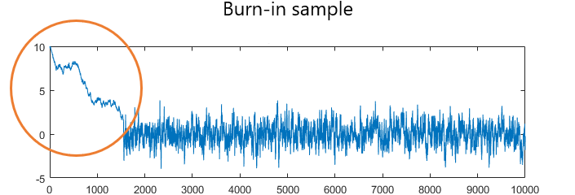
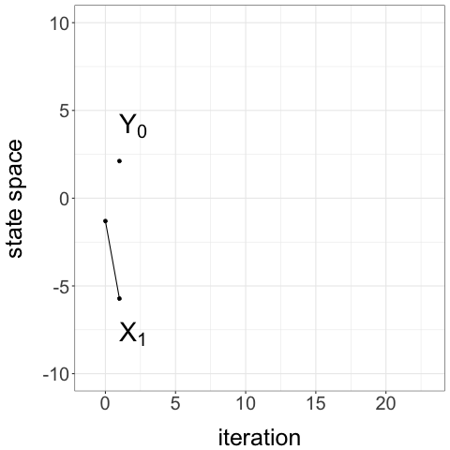
Gained experience by reading papers and breaking them down into fundamental topics.
Interesting Paper: Unbiased Markov Chain Monte Carlo with Coupling – Jacob, Leary, Atchade
MCMC algorithm very useful in finance, particularly useful for estimation of parameters in Bayesian models
Typical MCMC requires a “burn-in” period of some number of iterations before accessing the area we want to sample from
This is still biased, there’s nothing saying that these estimates are the actual ones
This paper finds that using two chains and sampling after they meet gives an unbiased estimate of your parameter of interest!
Notes:
Christo

Slide 12
QUESTIONS AND ANSWERS
Contact us!
Email: quants@case.edu
Instagram: @cwruquants

